Slide 1
Clean Architeture
DDD

Slide 2
现状
未使用正确的分层架构设计
代码重复，难以扩展
易出bug，且难以定位

Slide 3
解决方案
选择一个好的架构设计方案
Clean Architecture, DDD
Separation of Concerns
Encapsulation
Dependency Inversion
Explicit Dependencies
Single Responsibility
DRY
Persistence Ignorance

Slide 4
应用程序架构
All-in-one
N-Layers
干净架构

Slide 5
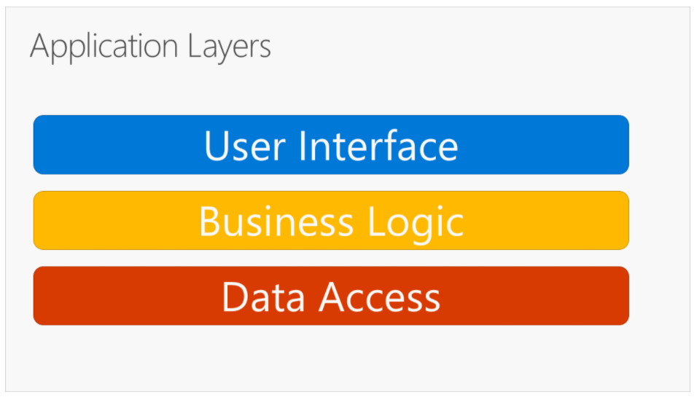
传统三层架构

Slide 6
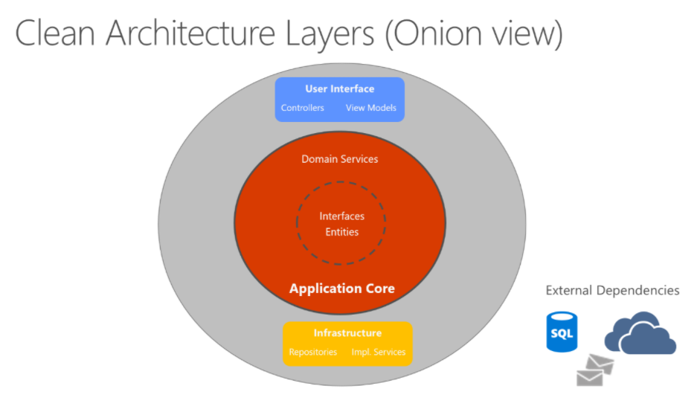
干净架构

Slide 7
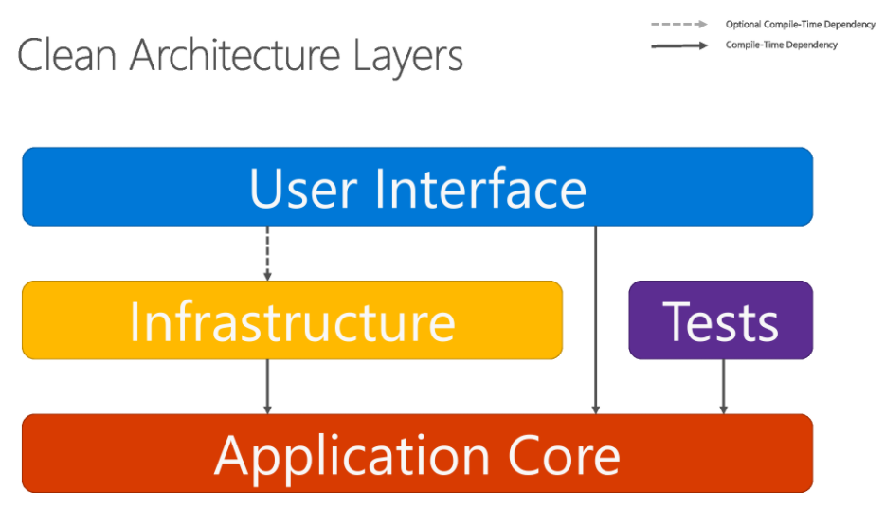
干净架构

Slide 8
Clean Architecture VS DDD
Clean Architecture | DDD
Application Core | Domain Model
Infrastructure | Infrastructure
User Interface | Application

Slide 9
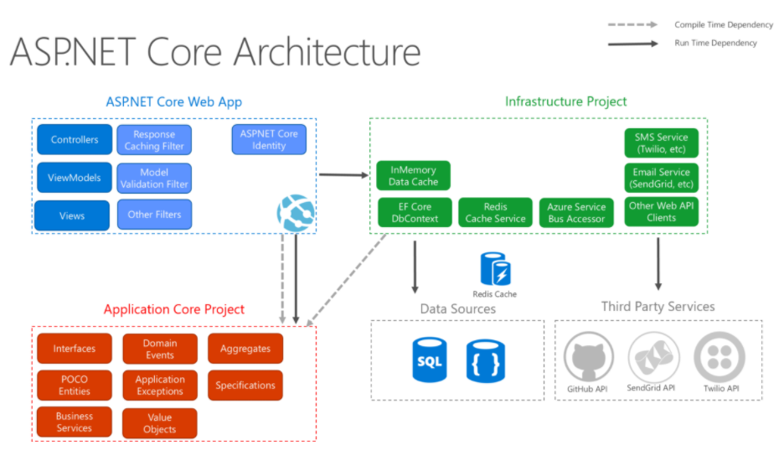
干净架构

Slide 10
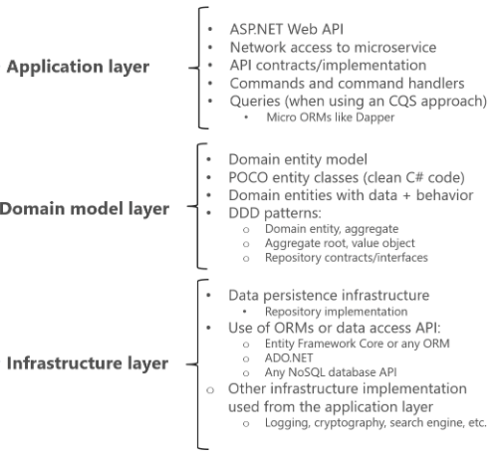

Slide 11
Domain Entity Pattern
Rich, not anemic.
避免业务逻辑四处分布在应用层。

Slide 12
Aggregate Pattern
A group of entities and behaviors that can be treated as a cohesive unit.
Aggregate root, invariants.
Disallow direct navigation between aggregates.

Slide 13
CQS
Queries
Query database and return result to client.
Do not change system state, no side effects.
View model.
Not restricted by aggregate.
Command
Change system state.
Domain model.
Restricted by aggregate.
Immutable.
Either query or command, not both.

Slide 14
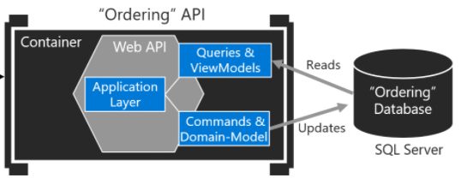
CQS

Slide 15
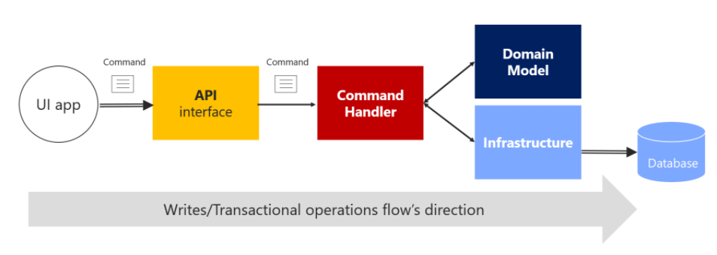
Command Pattern

Slide 16
Command Handler
It receives the command object, like a DTO.
It validates that the command is valid.
It instantiates the aggregate root instance that is the target of the current command.
It executes the method on the aggregate root instance, getting the required data from the command.
It persists the new state of the aggregate to its related database. This last operation is the actual transaction.

Slide 17
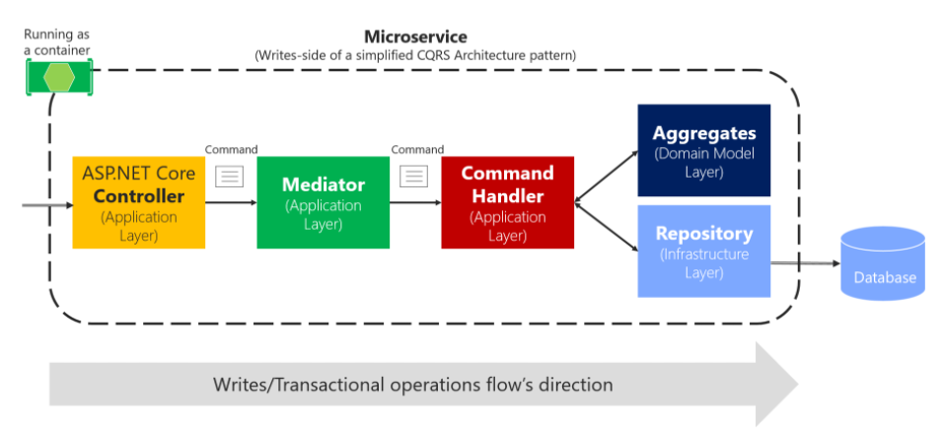
Mediator Pattern

Slide 18
Cross-cutting Concerns
Logging
Validation

Slide 19
Idempotent Command

Slide 20
Domain Event
Something happened in the domain that you want other parts of the same domain (in-process) to be aware of.
Be used to propagate state changes across multiple aggregates within the same domain model.
Side effects are expressed explicit.
Single responsibility principle.
Open / close principle.
Same domain, transaction.

Slide 21
Repository Pattern
Encapsulate, centralize common data access logic.
The only channel to update database.
One repository per aggregate.
Control aggregate's invariants and transactional consistency.
Decouple infrastructure from domain model layer, easier to unit test.

Slide 22
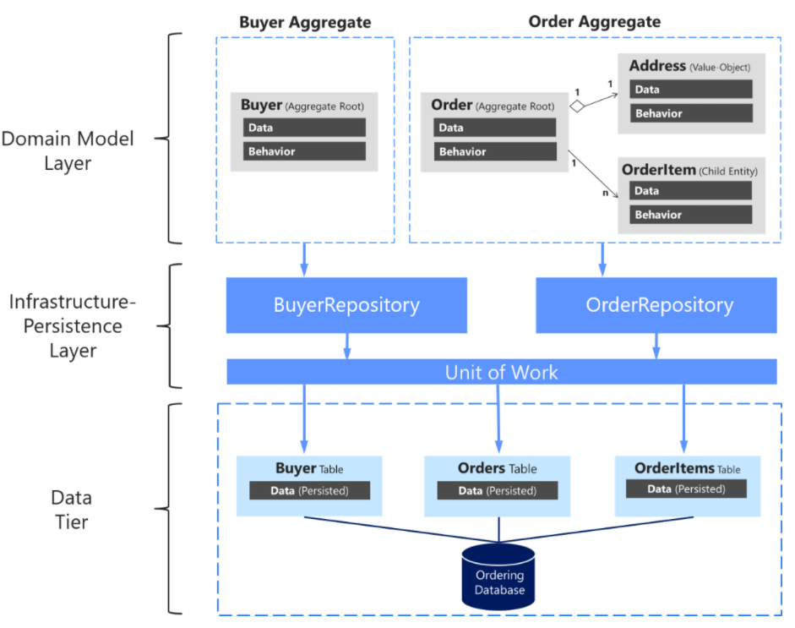

Slide 23
Repository VS DAL
DAL
Directly operation on database.
Repository
In-memory change, UOW.
Increase performance.
Reduce transaction blocking.
Reduce inconsistencies.

Slide 24
References
.NET Microservices: Architecture for Containerized .NET Applications
https://docs.microsoft.com/en-us/dotnet/architecture/microservices/
Microservices Patterns: With examples in Java
https://www.amazon.com/Microservices-Patterns-examples-Chris-Richardson/dp/1617294543
Effective Aggregate Design
https://www.dddcommunity.org/wp-content/uploads/files/pdf_articles/Vernon_2011_1.pdf

